Slide 1

Western Project Pre-Implementation Survey
Hannah DeBruin
Weekly Meeting: Transit Data Subgroup
01/17/22

Slide 2
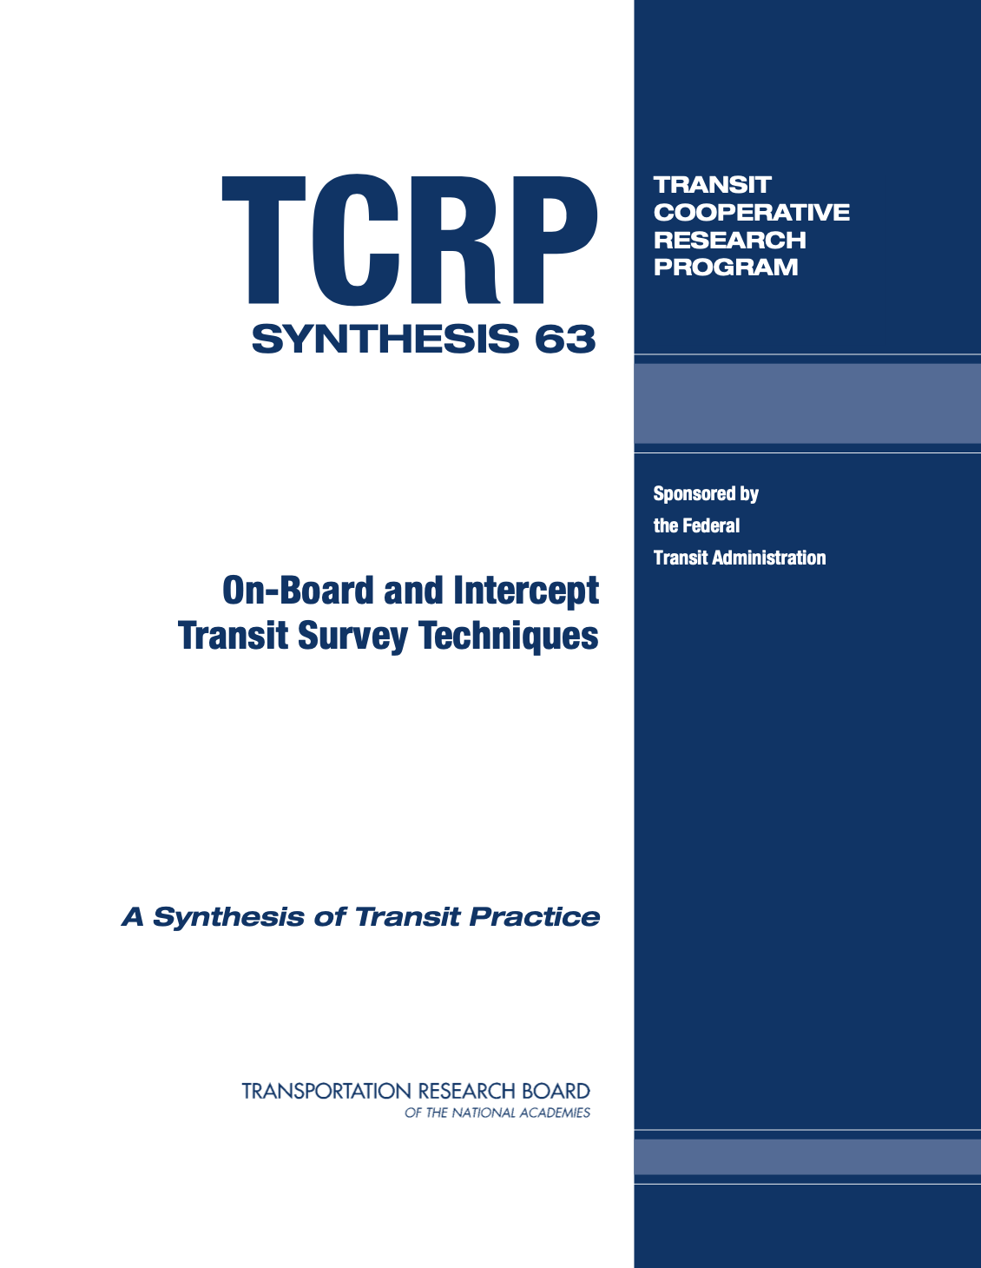
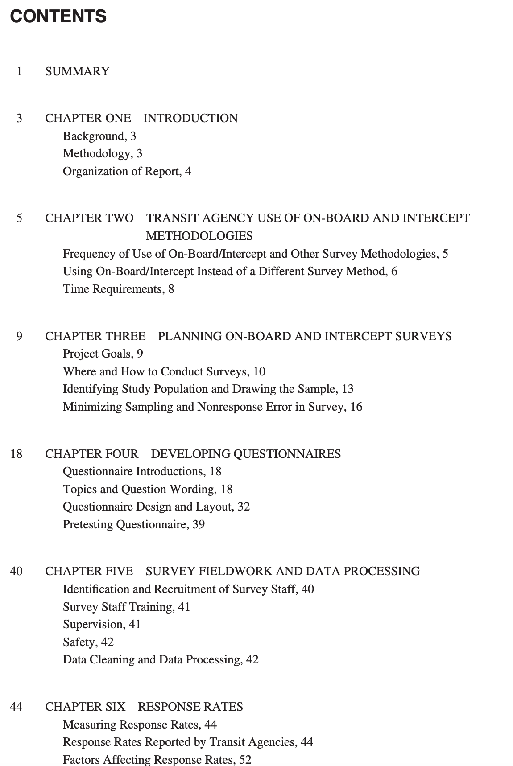
TCRP Sample Design
Weekly Meeting (01/17/2023)
Hannah DeBruin

Slide 3
TCRP Sample Design
Theoretical Population = Study Population
In Western project, population is riders of transit services (attitudes)
In Southern project, population is trips taken on transit services (O&D patterns)
Sample Frame: the specific routes & trips surveyed
One approach is to survey only high ridership routes. However, lower ridership routes may produce different, uncaptured results.
Can be further defined by time of day, choice of weekday/weekend, and direction of travel for a representative sample
Weekly Meeting (01/17/2023)
Hannah DeBruin

Slide 4
TCRP Sample Design
A subset of the sample frame is usually selected through simple random procedures
Maintain the principal that each unit has an equal chance of being selected. However, can be logistically difficult if workers must continuously move between routes, directions, trips, etc
Usually every nth rider is chosen for on-board sampling. Some agencies are less strict and instead instruct operators to distribute surveys to a cross section of riders, which can affect the integrity of the sample, but might be logistically/budgetarily necessary
Weekly Meeting (01/17/2023)
Hannah DeBruin

Slide 5
TCRP Sample Design
Stratified Sampling was used by ¼ of transit agencies
Most often applied to time of day, route, and direction to ensure that peak and non-peak hours, each route, and each direction, are represented in the sample
Divide sample frame into relatively homogeneous, mutually exclusive and exhaustive subsets (strata), then choose a simple random sample of elements from each subset
Some agencies stratified based on service area, some on groupings of bus routes
Almost universally, agencies reported using the same sampling fraction for each strata (aka a proportionate stratified random sample)
Alternatively, can use different fractions to provide statistically significant results for relatively small subgroups (like Kwangho did for the Western project)
Either way, weights for each strata are most commonly based on ridership (like Kwangho did for the Western project)
Weekly Meeting (01/17/2023)
Hannah DeBruin

Slide 6
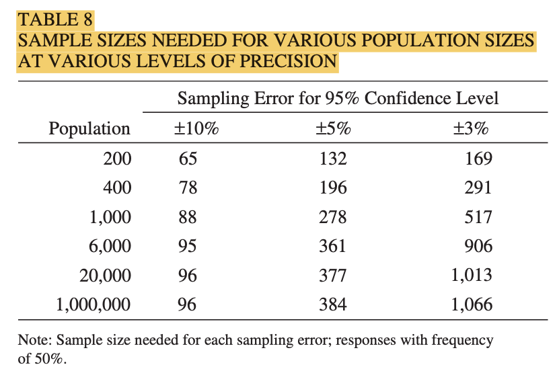
Accounting for Sampling Error
Sample size needed depends on the population size and level of precision desired
Weekly Meeting (01/17/2023)
Hannah DeBruin

